Slide 1

Devanagari Handwritten Character Classification
Sanjay Jaras
Bellevue University

Slide 2
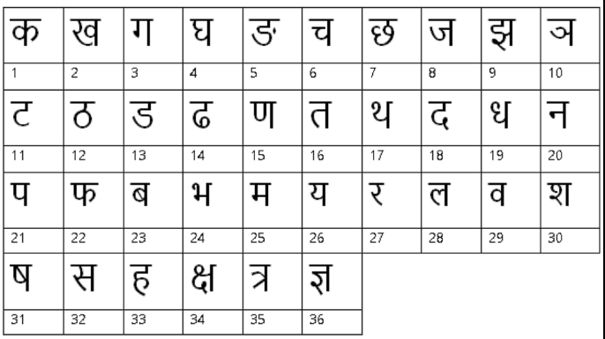

Introduction and Problem Statement
Devanagari Script
Problem Statement

Slide 3
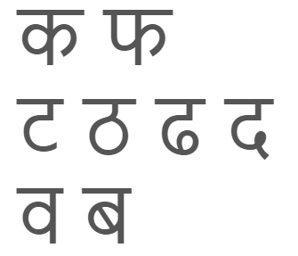
Introduction and Problem Statement
Offline Handwritten Recognition
Complexity
Similar letters Different styles of writing

Slide 4
Steps Performed
Data gathering
Data understanding
Data preparation
Model Compilation
Model Training
Testing model

Slide 5
Dataset
Source: Center for Machine Learning and Intelligent Systems
46 classes
2000 images per class
Dataset split in 85-15
32x32 image size

Slide 6
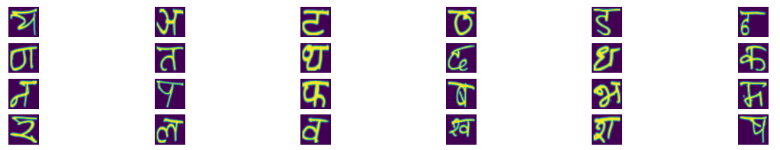
Data Understanding
Folder Structure
92,000 images
78,200 images in Training dataset
Equal samples for each character

Slide 7
Machine Learning
Scikit-learn Models
Data frame with 1025 columns
1024 pixel columns
Normalization
Label Encoding

Slide 8
Machine Learning
Grid search
KNeighborsClassifier, DecisionTreeClassifier, RandomForestClassifier, LGBMClassifier, SVM
9 + 3 + 3 + 18 + 6 = 39 Models Trained
Problem with: GradientBoostingClassifier, XGBClassifier

Slide 9
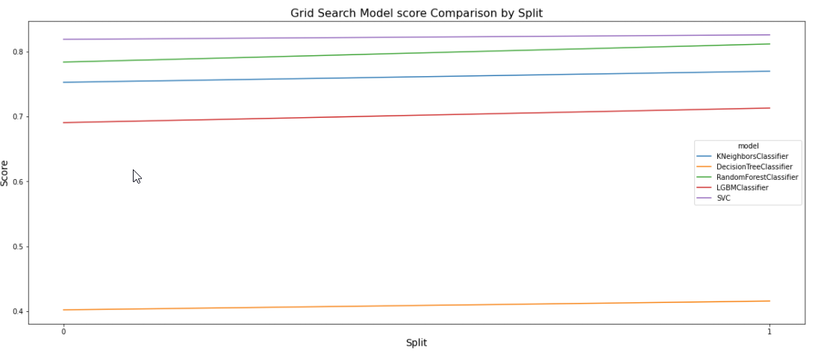
Machine Learning
Grid search

Slide 10
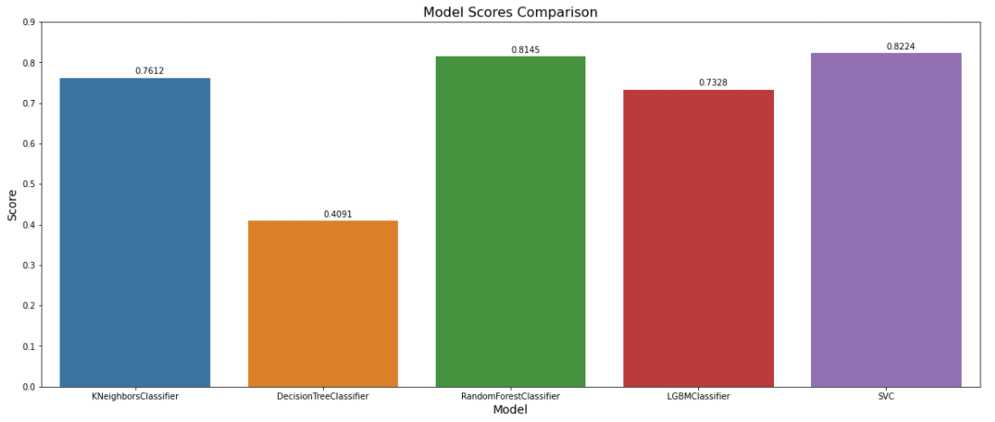
Machine Learning
Grid search

Slide 11
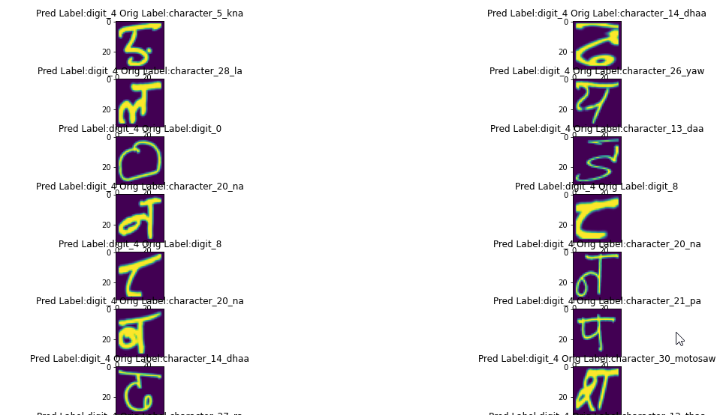
Machine Learning
Best Model: SVM
Best Model Accuracy on Test Dataset: 66.20%

Slide 12
Deep Learning
Tensorflow CNN
Augmentation
Vocabulary of labels
TensorDataset
Dataset Split
Batches of 32

Slide 13
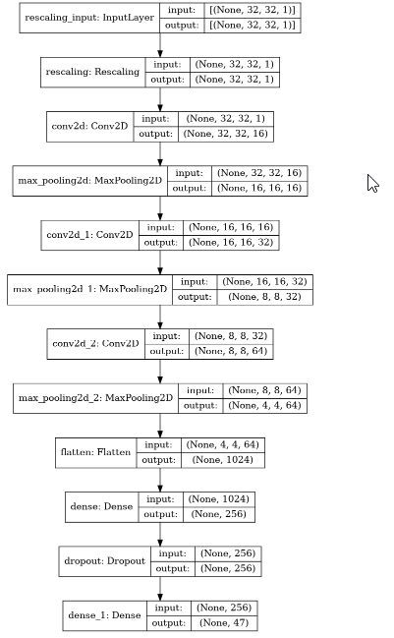
Deep Learning
Define Model
Compile Model

Slide 14
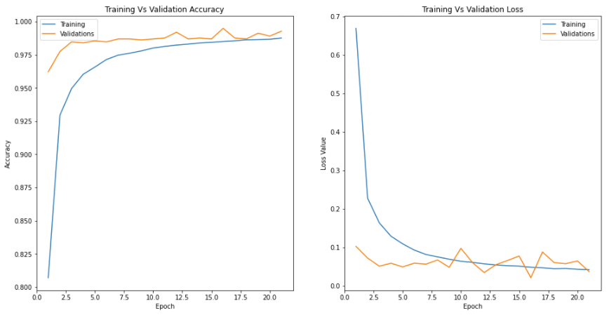
Deep Learning
Model Training

Slide 15
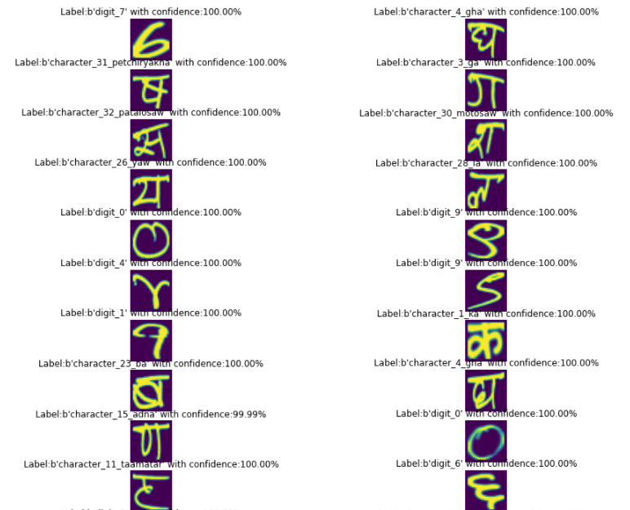
Deep Learning
Model Score on Test: 98.83% with 0.07 Loss

Slide 16
Thank You!

